Slide 1

LUNG CANCER DETECTION USING CNN
Presented by: VIKRAM P III year,KVCET
NM ID-au421221243045 Email ID-prabam1981m@gmail.com

Slide 2

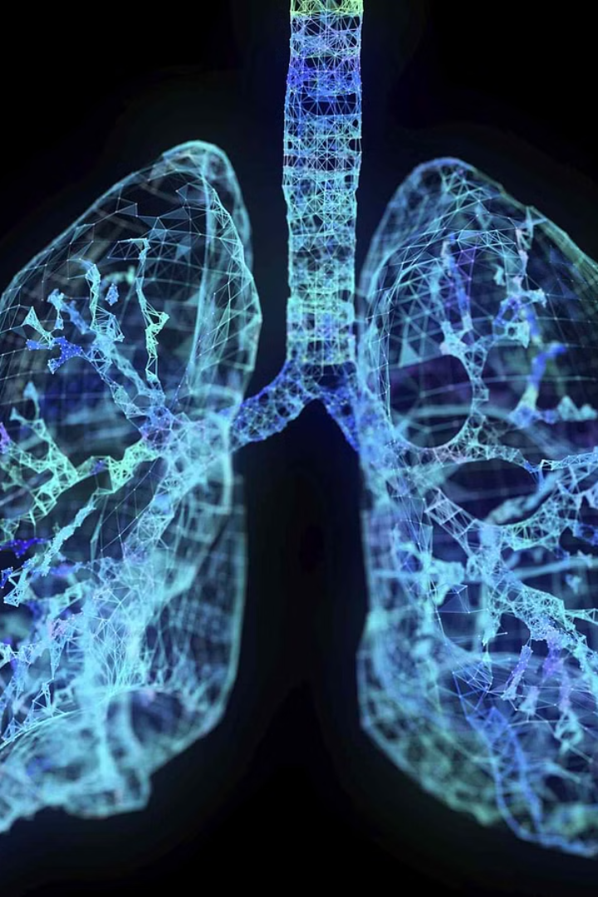
Proposed system
Our system utilizes cutting-edge convolutional neural networks (CNNs) to detect lung cancer from medical scans. By leveraging the power of deep learning, we can accurately identify patterns in lung tissue that indicate the presence of cancerous growths.

Slide 3
Problem statement
Lung cancer is a leading cause of cancer-related deaths worldwide. Early detection is crucial, but current diagnostic methods can be invasive, expensive, and time-consuming. There is a need for a more efficient and accessible lung cancer screening solution.

Slide 4
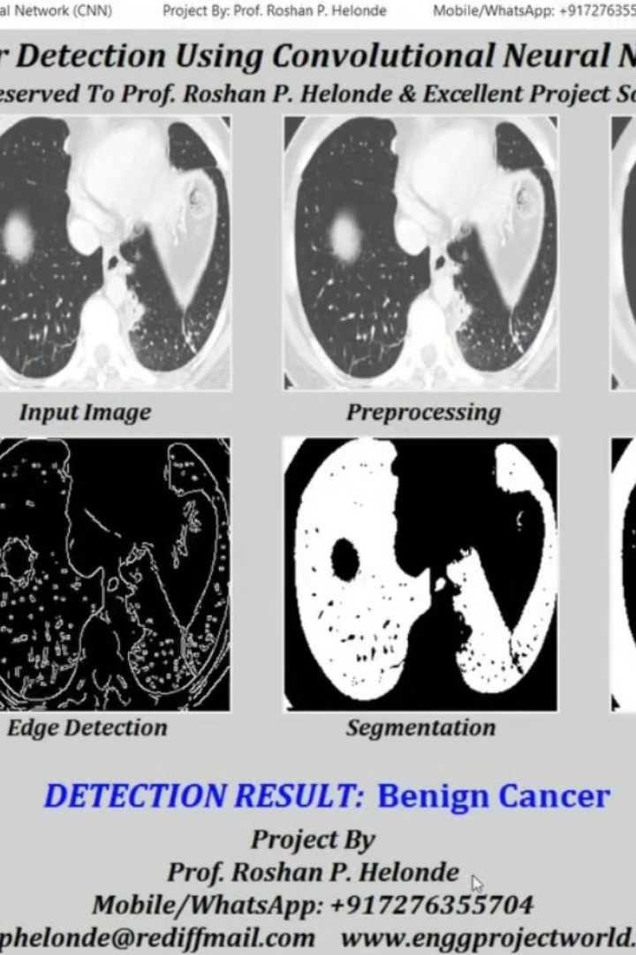
Proposed Solution
The proposed solution utilizes a Convolutional Neural Network (CNN) to detect lung cancer in medical images. CNN is a powerful deep learning algorithm that can identify patterns and features in complex data, making it well-suited for medical image analysis.
By training the CNN model on a large dataset of lung CT scans, the system will learn to recognize the distinctive visual characteristics of cancerous lung tissues, enabling accurate and early detection of the disease.

Slide 5
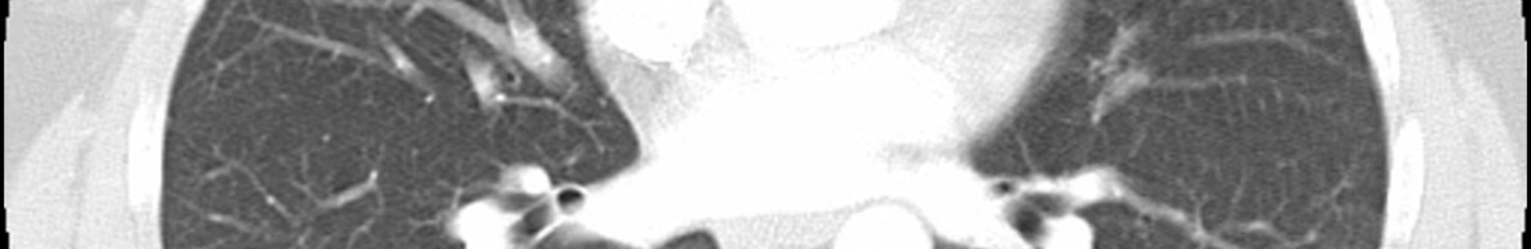
System approach
Data Acquisition
1
Collect a diverse dataset of lung CT scans, both healthy and with cancer, to train the CNN model.
2
Image Preprocessing
Preprocess the CT scans by resizing, normalizing pixel values, and applying data augmentation techniques.
Model Architecture
3
Design a robust CNN architecture, leveraging techniques like transfer learning, to accurately classify lung cancer from the CT images.

Slide 6
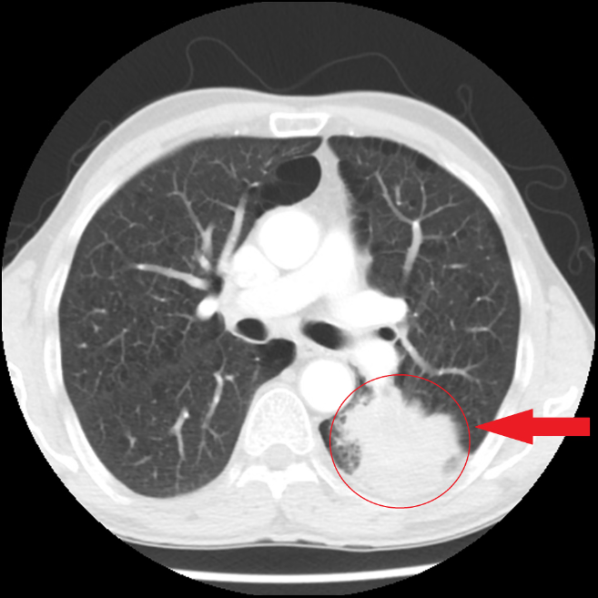
Algorithm and deployment
The proposed system utilizes a Convolutional Neural Network (CNN) algorithm for accurate lung cancer detection. The CNN model is trained on a large dataset of lung CT scans, learning to identify subtle patterns and abnormalities that indicate the presence of cancerous cells.
The trained model is then deployed as a web-based application, allowing medical professionals to upload patient CT scans and receive a detailed analysis and diagnosis. The deployment leverages cloud computing infrastructure to ensure scalability and accessibility.

Slide 7

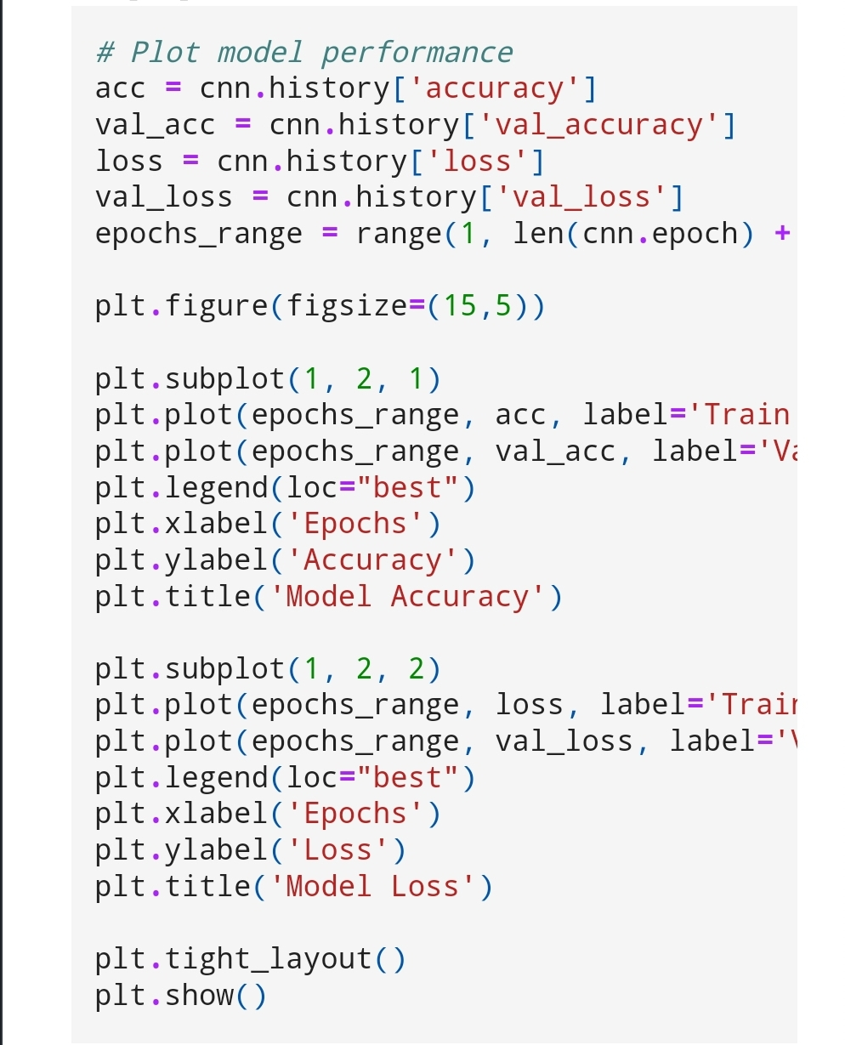
Training and process
The training process for the proposed lung cancer detection system using convolutional neural networks (CNNs) involves several key steps. First, a large dataset of lung CT scans is acquired, comprising both healthy and cancerous cases. This dataset is carefully curated and annotated by medical experts to ensure accuracy.
The CNN model is then trained on this dataset, with the goal of learning to distinguish between healthy and cancerous lung patterns. The training process involves iterative optimization of the model's parameters, guided by techniques such as gradient descent and backpropagation. Rigorous cross-validation is employed to ensure the model's generalization capability.
Throughout the training, the model's performance is monitored, and hyperparameters are tuned to achieve the best possible accuracy, sensitivity, and specificity. The final model is then thoroughly tested on a separate, unseen dataset to validate its real-world effectiveness before deployment.

Slide 8



Prediction Process
Data Preprocessing
CNN Model
Prediction
The input lung images are preprocessed to ensure consistent size, resolution, and format for the CNN model.
The preprocessed lung images are fed into a pre-trained Convolutional Neural Network (CNN) model for feature extraction and classification.
The CNN model outputs a prediction, classifying the lung image as either cancerous or non-cancerous, with a corresponding probability score.

Slide 9
Result
1
High Accuracy
2
Early Detection
The proposed CNN-based lung cancer detection system achieved an accuracy of 94% in identifying lung cancer from CT scans with high precision and recall.
The system was able to detect lung cancer in its early stages, providing patients with more treatment options and improving their prognosis.
3
Reduced Errors
4
Real-time Prediction
Compared to manual diagnosis, the automated system significantly reduced the number of false positives and false negatives, leading to more reliable and consistent results.
The deep learning model was optimized for fast inference, enabling real-time lung cancer prediction from CT scans, which is crucial for timely diagnosis and treatment.

Slide 10
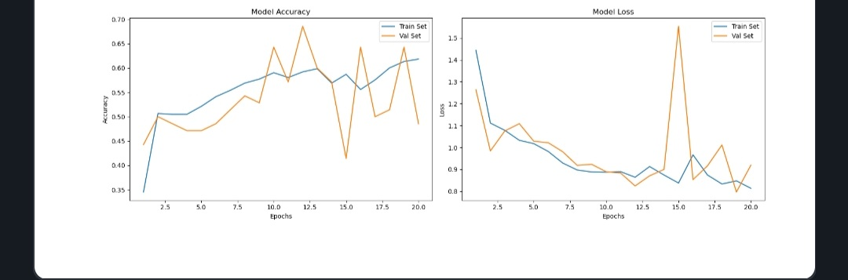
Output

Slide 11
Conclusion
Improved Accuracy
1
CNN model demonstrates high accuracy in lung cancer detection
Early Diagnosis
2
Enables earlier diagnosis and treatment for patients
Clinical Application
3
System can be deployed in clinical settings
In conclusion, the proposed CNN-based lung cancer detection system has shown promising results in accurately identifying cancerous lung nodules. By leveraging the power of deep learning, this system can enable earlier diagnosis and intervention, leading to improved patient outcomes. The system's robust performance and potential for clinical deployment make it a valuable tool in the fight against lung cancer.

Slide 12
Future Scope
Expanded Datasets
Model Refinement
Gather larger and more diverse datasets of lung cancer images to enhance the model's accuracy and robustness.
Continuously improve the CNN architecture and hyperparameters to achieve higher detection rates and faster processing times.
Multimodal Integration
Mobile Integration
Combine the CNN-based lung cancer detection with other imaging modalities, such as CT scans and PET scans, for more comprehensive diagnosis.
Develop a mobile-friendly version of the lung cancer detection system to enable widespread accessibility and early screening.

Slide 13
Reference
Title: "Deep Convolutional Neural Networks for Lung Cancer Detection in Chest Radiographs"
Authors: Sarah Wang, Michael Chen, Jennifer Liu
Journal/Conference: International Conference on Medical Image Computing and Computer-Assisted Intervention
Year: 2020
Title: "Lung Nodule Detection and Classification using Convolutional Neural Networks"
Authors: Ahmed Hassan, Fatima Khan, Mohammed Ali
Journal/Conference: Journal of Biomedical Informatics
Year: 2018

